Slide 1
CHAPTER - 10 LIGHT : REFLECTION AND REFRACTION
Notes:
*

Slide 2
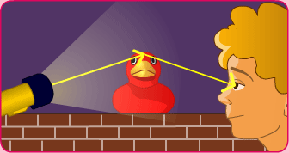
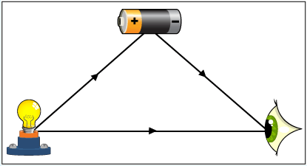
1) Light :-
i) Light is a form of energy which helps us to see objects.
ii) When light falls on objects, it reflects the light and when the
reflected light reaches our eyes then we see the objects.
iii) Light travels in straight line.
iv) The common phenomena of light are formation of shadows,
formation of images by mirrors and lenses, bending of light by a
medium, twinkling of stars, formation of rainbow etc.

Slide 3
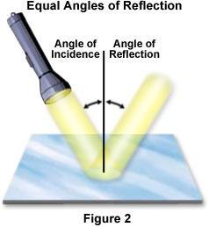
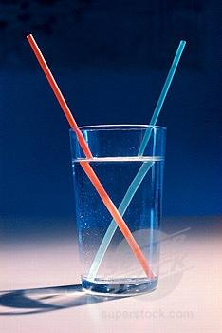
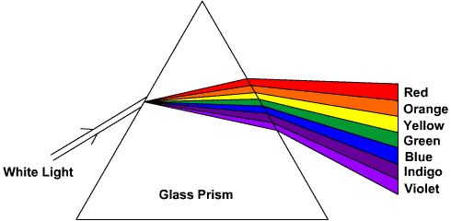

Slide 4
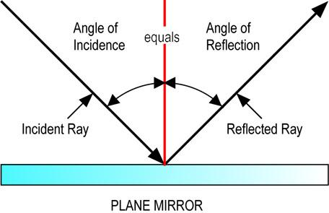
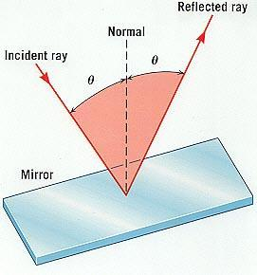
2a) Reflection of light :-
When light falls on a highly polished surface like a mirror most of
the light is sent back into the same medium. This process is called
reflection of light.
a) Laws of reflection of light :-
i) The angle of incidence is equal to the angle of reflection.
ii) The incident ray, the reflected ray and the normal to the mirror at
the point of incidence all lie in the same plane.

Slide 5
What is meant by reflection of light?
The throwing back by a body or surface, of light, without absorbing it.

Slide 6
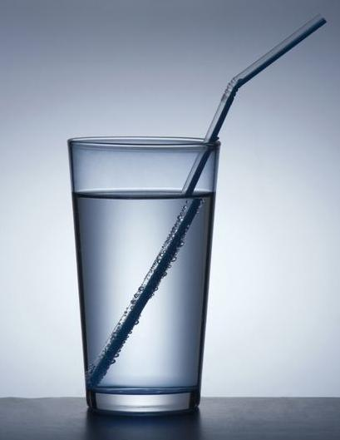
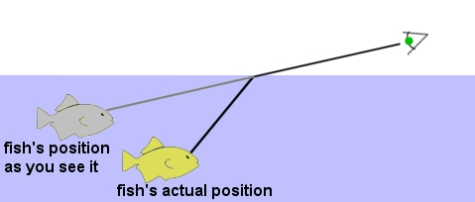
What is meant by Refraction?
The bending of light ray when it passes from one medium into another in which its speed is different

Slide 7
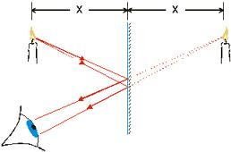
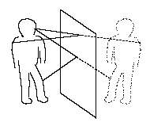
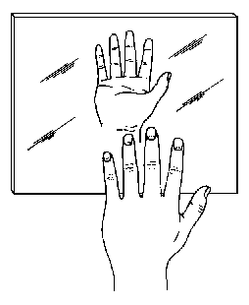
Images formed by plane mirror
i) The image is erect.
ii) The image is same size as the object.
iii) The image is at the same distance from the mirror as the object is in
front of it.
iv) The image is virtual (cannot be obtained on a screen).
v) The image is laterally inverted.

Slide 8
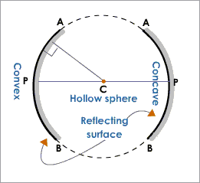
3) Spherical mirrors :-
Spherical mirror is a curved mirror which is a part of a hollow sphere. Spherical mirrors are of two types. They are concave mirror and convex mirror.

Slide 10
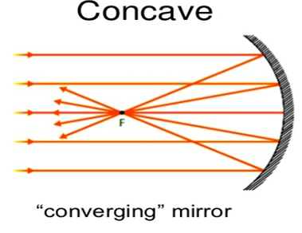
i) Concave mirror :- is a spherical mirror whose reflecting surface is curved inwards. Rays of light parallel to the principal axis after reflection from a concave mirror meet at a point (converge) on the principal axis

Slide 11
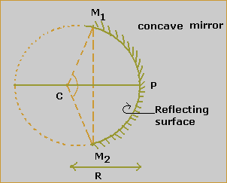
Concave mirror whose reflecting surface is towards the centre of the sphere of which the mirror is a part.

Slide 13
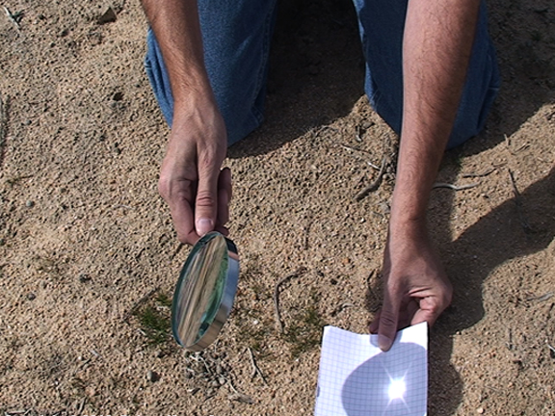

Slide 14
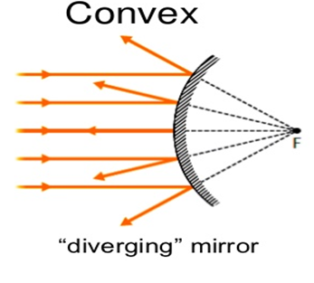
ii) Convex mirror :- is a spherical mirror whose reflecting surface is curved outwards. Rays of light parallel to the principal axis after reflection from a convex mirror get diverged and appear to come from a point behind the mirror.

Slide 15
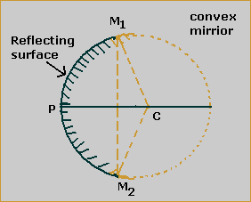
Convex mirror is one whose reflecting surface is away from the centre of the sphere of which the mirror is a part

Slide 18
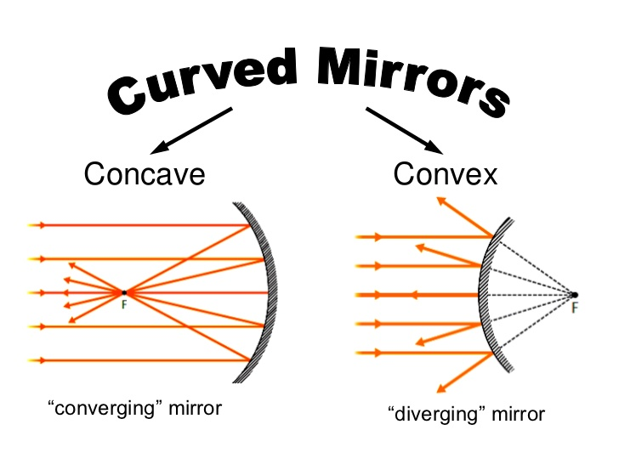

Slide 19
4) Terms used in the study of spherical mirrors

Slide 20
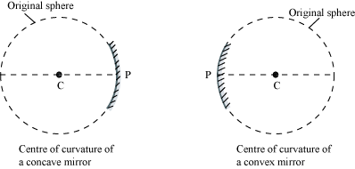
i) Center of curvature - is the centre of the sphere of which the mirror is a part (C).

Slide 21
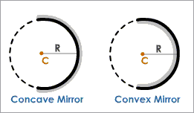
ii) Radius of curvature - is the radius of the sphere of which the mirror is a part (R)

Slide 22
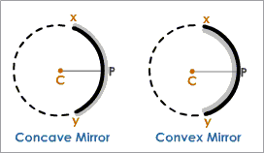
iii) Pole or Vertex- is the centre of the spherical mirror (P).

Slide 23
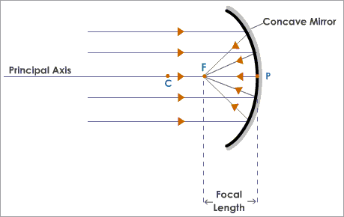
iv) Principal focus - In a concave mirror, rays of light parallel to the principal axis after reflection meet at a point on the principal axis called principal focus(F).

Slide 24
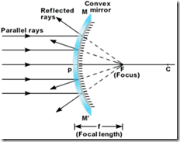
iv) Principal focus - In a convex mirror, rays of light parallel to the principal axis after reflection get diverged and appear to come from a point on the principal axis behind the mirror called principal focus (F).

Slide 25
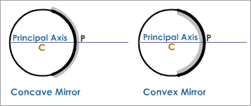
iv) Principal axis - is the straight line passing through the centre of curvature and the pole

Slide 26
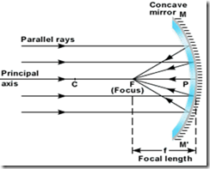
v) Focal length - is the distance between the pole and principal focus (f). In a spherical mirror the radius of curvature is twice the focal length. R = 2f

Slide 27
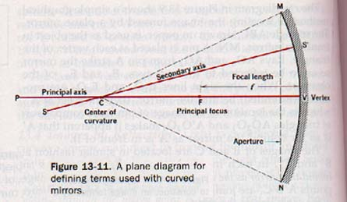
vi) The diameter of the reflecting surface of spherical mirror is called its APERTURE.

Slide 28
X C F P Y
C – centre of curvature CP – radius of curvature
P – pole XY – principal axis
F – principal focus PF – focal length

Slide 29
5) Reflection by spherical mirrors

Slide 30
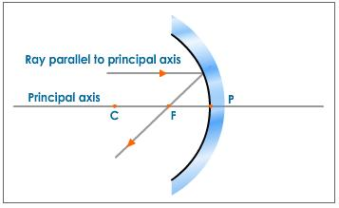
1. a) A ray of light parallel to the principal axis after reflection from a concave mirror passes through its focus.

Slide 31
1. b) In a convex mirror a ray of light parallel to the principal axis after reflection appears to diverge from the focus.
P F C

Slide 32
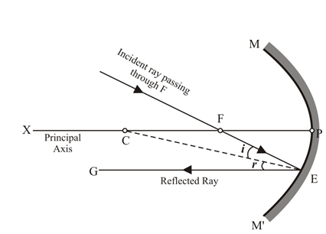
2.a) A ray of light passing through the focus of a concave mirror after reflection emerges parallel to the principal axis.

Slide 33
2. b) In a convex mirror a ray of light directed towards the focus after reflection goes parallel to the principal axis.
P F C

Slide 34
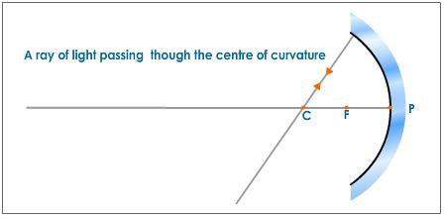
3. a) In a concave mirror a ray of light passing through the centre of curvature after reflection is reflected back along the same direction..

Slide 35
3. b) In a convex mirror a ray of light directed towards the centre of curvature after reflection is reflected back along the same direction.
P F C

Slide 36
4) In a concave or a convex mirror a ray of light which strikes the mirror at its pole gets reflected according to the law of reflection.
C F i P i P F C
r r

Slide 37
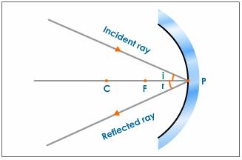

Slide 38
LEARNING OBJECTIVE
To construct ray diagram showing the formation of the real image of an object when it is placed in front of a concave mirror.
To interpret the characteristics of the image formed by a concave mirror.
To apply in the real life situation.

Slide 39
6) Images formed by concave mirror :-
i) When the object is at infinity the image is formed at the focus, it is highly diminished, real and inverted.
C F P

Slide 40
ii) When the object is beyond C, the image is formed between C and F, it is diminished, real and inverted.
C F P

Slide 41
iii) When the object is at C, the image is formed at C, it is same size as the object, real and inverted.
C F P

Slide 42
iv) When the object is between C and F, the image is formed beyond C, it is enlarged, real and inverted.
C F P

Slide 43
v) When the object is at F, the image is formed at infinity, it is highly enlarged, virtual and erect.
C F P

Slide 44
vi) When the object is between F and P, the image is formed behind the mirror, it is enlarged, virtual and erect.
C F P

Slide 45
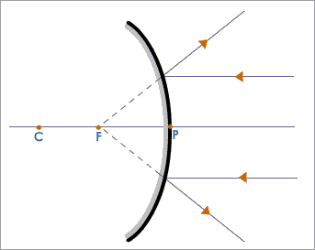
7) Images formed by convex mirror :-
i) When the object is at infinity, the image is formed at F behind the mirror, it is highly diminished, virtual and erect.

Slide 46
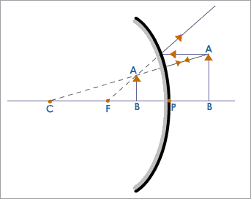
ii) When the object is between infinity and pole, the image is formed behind the mirror, it is diminished, virtual and erect.

Slide 47
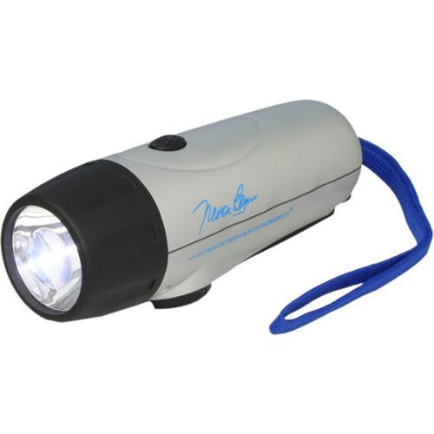
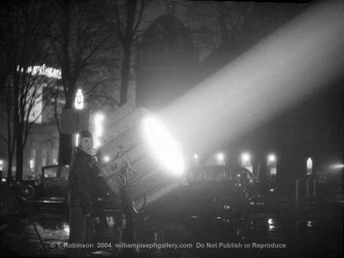
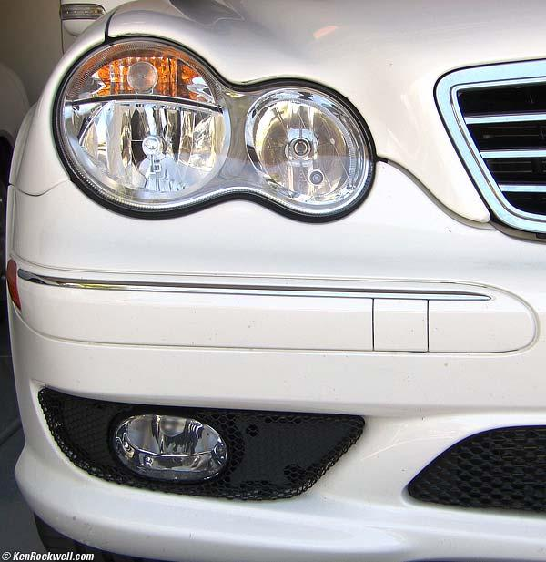
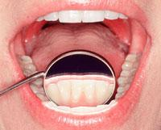
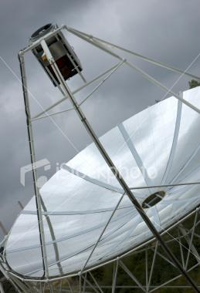
8) Uses of spherical mirrors :-
a) Concave mirrors :-
Concave mirrors are used in torches, search lights and head lights of vehicles to get parallel beams of light.
They are used as shaving mirrors to see larger image of the face.
They are used by dentists to see larger images of the teeth.
Large concave mirrors are used to concentrate sunlight to produce heat in solar furnaces.

Slide 48
b) Convex mirrors :-
Convex mirrors are used as rear-view mirrors in vehicles. Convex mirrors give erect diminished images of objects. They also have a wider field of view than plane mirrors.

Slide 49
Difference between convex mirror and convex lens
S.NO | CONVEX MIRROR | CONVEX LENS
1. | Opaque | Transparent
2. | Causes reflection of light | Causes refraction of light
3. | forms only virtual, diminished and erect images for all positions of the object | form both real, inverted images of various sizes and virtual, erect and enlarged images depending on the position of the object.

Slide 50
Difference between concave mirror and concave lens
S.NO | CONCAVE MIRROR | CONCAVE LENS
1 | Opaque | Transparent
2 | Causes Reflection of light | Causes Refraction of light
3 | Form both real, inverted images of various sizes and virtual, erect and enlarged images depending on the position of the object | Forms only virtual, diminished and erect images for all positions of the object.

Slide 51
S.NO | REAL IMAGE | VIRTUAL IMAGE
1 | Real images can be captured on the screen | Virtual images cannot be captured on a screen
2 | The rays of light after reflection or refraction appear to meet at a point or appear to diverge from a point | The rays of light after reflection or refraction appear to meet at a point or appear to converge from a point
3 | It is always inverted | It is always erect but laterally inverted

Slide 52
9) New Cartesian sign convention for spherical mirrors :-
i) The object is always placed on the left of the mirror and light from the object falls from the left to the right.
ii) All distances parallel to the principal axis are measured from the pole.
iii) All distances measured to the right of the pole are taken as + ve.
iv) All distances measured to the left of the pole are taken as – ve.
v) The height measured upwards perpendicular to the principal axis is taken as + ve.
vi) The height measured downwards perpendicular to the principal axis is taken as – ve.
^{Object}
^{Direction of incident light}
^{Height}
^{upwards ( + ve )}
Distance towards the left ( - ve )
Distance towards the right ( + ve )
^{Height}
^{downwards ( - ve )}
^{Image}
Notes:
*

Slide 53
10a) Mirror formula for spherical mirrors :-
The mirror formula for spherical mirrors is the relationship between the object distance (u), image distance (v) and focal length (f).
The mirror formula is expressed as :-
1 1 1
+ =
u v f
b) Magnification for spherical mirrors :-
Magnification for spherical mirrors is the ratio of the height of the image to the height of the object.
Height of the image h_{i}
Magnification = m =
Height of the object h_{o}
The magnification is also related to the object distance and image distance. It is expressed as :-
h_{i} v
Magnification m = =
h_{o} u
Notes:
*

Slide 54
1. The height of the image should be taken as positive for virtual and erect images. 2. The height of the image should be taken as negative for real and inverted images.

Slide 55
Linear Magnification produced by a concave mirror

Slide 56
1. When image is magnified or enlarged, size of the image is greater than the size of the object, h_{i}>h_{o} m > 1 2. When image is of the same size as that of the object, h_{i} = h_{o} m = 1 3. When image is smaller than the object, h_{i}<h_{o} m<1

Slide 58
Concave Mirror: 1. When the image is real it is inverted, i.e the image lies below the principal axis. Therefore height of the image (h_{i}) is negative, As height of the object (h_{o}) is always positive. m = h_{i}/h_{o} = negative 2. When the image is virtual, it is erect, i.e the image lies above the principal axis. Therefore height of the image (h_{i}) is positive, As height of the object (h_{o}) is always positive m = h_{i}/h_{o} = positive

Slide 59
Mirror Formula 1/f = 1/u + 1/v In Concave mirror, as the object is in front of a mirror (say to the left) object distance is always negative. The image is formed at the back of the mirror i.e to the right of pole. Therefore image distance is always positive. As focus F is at the back of the mirror, focal length (f) of the convex mirror is always positive.

Slide 61
Linear Magnification produced by a convex mirror

Slide 62
The formula for linear magnification m for a convex mirror is same as that for a concave mirror, i.e., m = h_{i}/h_{o} = -v/u Object size is positive. As the image is always virtual and erect, image size is also positive. Therefore m can have positive values only.

Slide 63
How to distinguish between a Plane Mirror, A Concave mirror, A Convex mirror without touching them?
1. A Plane Mirror produces Virtual, erect image of the same size as our face, i.e., we look our normal self.
2. A Concave mirror produces a virtual, erect and magnified image of our face (held close to mirror) i.e., our face looks much bigger, when held within focus of mirror.
3. A Convex mirror produces a virtual, erect, but diminished image of our face i.e., our face looks much smaller

Slide 64
b) Refraction of light through a rectangular glass slab :-
When a ray of light passes through a rectangular glass slab, it gets bent twice at the air- glass interface and at the glass- air interface.
The emergent ray is parallel to the incident ray and is displaced through a distance.
^{Incident ray}
^{Normal}
Angle of incidence
^{i}
^{Air}
^{Glass}
Angle of refraction
^{r}
^{Refracted ray}
Rectangular glass slab
^{Glass}
^{Air}
^{e}
Angle of emergence
^{Emergent ray}
displacement
^{Normal}
Notes:
*

Slide 65
11a) Refraction of light :-
When light travels obliquely from one transparent medium into another it gets bent. This bending of light is called refraction of light.
When light travels from a rarer medium to a denser medium, it bends towards the normal.
When light travels from a denser medium to a rarer medium, it bends away from the normal.
Normal
Normal
^{Rarer medium}
^{Denser medium}
^{Denser medium}
^{Rarer medium}
Notes:
*
mmmmm

Slide 66
c) Laws of refraction of light :-
i) The incident ray, the refracted ray and the normal to the interface of two transparent media at the point of incidence, all lie in the same plane.
II) The ratio of the sine of angle of incidence to the sine of angle of refraction is a constant, for the light of a given colour and for the given pair of media.( This law is also known as Snell`s law of refraction.) sin i
= constant
sin r
d) Refractive index :-
The absolute refractive index of a medium is the ratio of the speed light in air or vacuum to the speed of light in medium.
Speed of light in air or vacuum c
Refractive index = n =
Speed of light in the medium v
The relative refractive index of a medium 2 with respect to a medium 1 is the ratio of the speed of light in medium 1 to the speed of light in medium 2.
^{n}₂₁ = Speed of light in medium 1 n ₂₁ ^{= v}₁ / v₂
^{Speed of light in medium 2}
Notes:
*

Slide 67
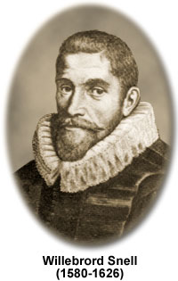
https://en.wikipedia.org/wiki/Willebrord_Snellius

Slide 68
12) Spherical lenses :-
A spherical lens is a transparent material bounded by two surfaces one or both of which are spherical.
Spherical lenses are of two main types. They are convex and concave lenses.
i) Convex lens :- is thicker in the middle and thinner at the edges. Rays of light parallel to the principal axis after refraction through a convex lens meet at a point (converge) on the principal axis.
ii) Concave lens :- is thinner in the middle and thicker at the edges. Rays of light parallel to the principal axis after refraction get diverged and appear to come from a point on the principal axis on the same side of the lens.
F F
Notes:
*

Slide 69
13) Refraction by spherical lenses :-
i) In a convex lens a ray of light parallel to the principal axis after refraction passes through the focus on the other side of the lens. In a concave lens it appears to diverge from the focus on the same side of the lens.
2F₁ F₁ O F₂ 2F₂ 2F₁ F₁ O F₂ 2F₂

Slide 70
ii) In a convex lens a ray of light passing through the focus after refraction goes parallel to the principal axis. In a concave lens a ray of light directed towards the focus after refraction goes parallel to the principal axis.
2F₁ F₁ O F₂ 2F₂ 2F₁ F₁ O F₂ 2F₂

Slide 71
iii) In a convex lens and concave lens a ray of light passing through the optical centre goes without any deviation.
2F₁ F₁ O F₂ 2F₂ 2F₁ F₁ O F₂ 2F₂

Slide 72
14) Images formed by convex lens :-
i) When the object is at infinity the image is formed at the focus F₂, it is highly diminished, real and inverted.
2F₁ F₁ O F₂ 2F₂

Slide 73
ii) When the object is beyond 2F₁, the image is formed between F₂ and 2F₂, it if diminished, real and inverted.
2F₁ F₁ O F₂ 2F₂

Slide 74
iii) When the object is at 2F₁, the image is formed at 2F₂, it is the same size as the object, real and inverted.
2F₁ F₁ O F₂ 2F₂

Slide 75
iv) When the object is between 2F₁ and F₁, the image is formed beyond 2F₂, it is enlarged, real and inverted.
2F₁ F₁ O F₂ 2F₂

Slide 76
v) When the object is at F₁ the image is formed at infinity, it is highly enlarged, real and inverted.
2F₁ F₁ O F₂ 2F₂

Slide 77
vi) When the object is between F₁ and O, the image is formed on the same side of the lens, it is enlarged, virtual and erect.
2F₁ F₁ O F₂ 2F₂

Slide 78
15) Images formed by concave lens :-
i) When the object is at infinity, the image is formed at the focus F₁ on the same side of the lens, it is highly diminished, virtual and erect.
F₁ O

Slide 79
ii) When the object is between infinity and F₁, the image is formed between F₁ and O on the same side of the lens, it is diminished, virtual and erect.
F_{I} O

Slide 80
16) Sign convention for spherical lenses :-
The sign convention for spherical lenses is the same as in spherical mirrors except that the distances are measured from the optical centre (O).
The focal length of a convex lens is positive ( + ve ) and the focal length of a concave lens is negative ( - ve ).
O
^{Object}
^{Direction of incident light}
^{Height}
^{upwards ( + ve )}
Distance towards the left (- ve )
Distance towards the right ( + ve )
^{Height}
^{downwards ( - ve )}
^{Image}
^{Convex lens}

Slide 81
17a) Lens formula for spherical lenses :-
The lens formula for spherical lenses is the relationship between the object distance (u), image distance (v) and focal length (f).
The lens formula is expressed as :-
1 1 1
=
v u f
b) Magnification produced by spherical lenses :-
Magnification for spherical lens is the ratio of the height of the image to the height of the object.
Height of the image h^{i}
Magnification = m =
Height of the object hº
The magnification is also related to the object distance and image distance. It can be expressed as :-
h^{i} v
Magnification m = =
hº u
Notes:
*

Slide 82
18) Power of a lens :-
The power of a lens is the reciprocal of its focal length (in metres).
I 1
P = or f =
f (m) P
The SI unit of power is dioptre (D).
1 dioptre is the power of a lens whose focal length is 1 metre.
The power of a convex lens is positive ( + ve ) and the power of a concave lens is negative ( - ve ).

